Slide 1
Power Management System in OSes for IoT
Xiaoyu MIN
EIT ICT Labs Embedded System
Aalto University, School of Science
Aalto University
ES Seminar
Cover
School of Science

Slide 2
Contents
Importance of EPM in IoT
Application-level EPM
Android wake lock for Applications
OS-level EPM
ACPI
Features in Mobile OS
Hardware EPM
PMIC (Power Management Integrated Chip)
ES Seminar
Contents

Slide 3

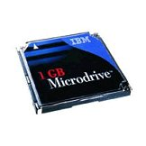
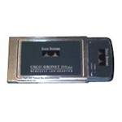
Need for improved power management
Capabilities of mobile handheld devices improving rapidly:
Wireless connectivity
Storage capacity
Battery capacity improving slowly
I/O devices decrease handheld battery lifetime by 60%
OEMs provide techniques to reduce battery consumption by severely compromising the performance
Careful power management needed
ES Seminar
EPM General

Slide 4
Power Management is essential in IoT Network
Sensor network are often designed for reliable real-time services in IoT
Limited resource and strict power consumption
Additional limitation towards some characteristics of conventional OS
Nodes are designed to operate with limited resources
Power: WSN based use batteries as a power supply
Memory and operational capabilities: sensing is less resource demanding than computation in conventional OS
Power management is very important in IoT
Various OS designed for IoT devices: TinyOS, Contiki OS, Android etc..
ES Seminar
EPM General

Slide 5
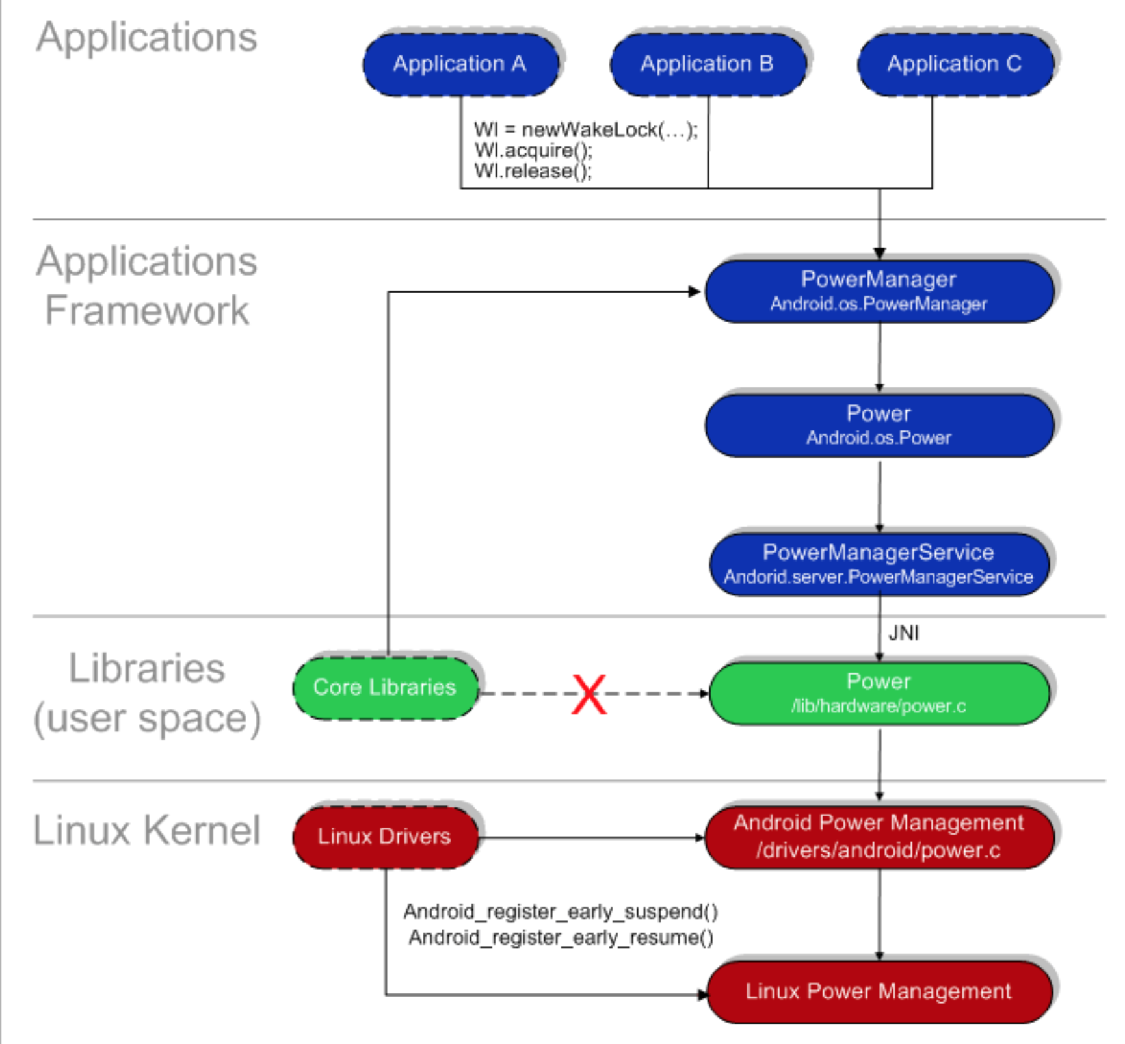

Slide 6
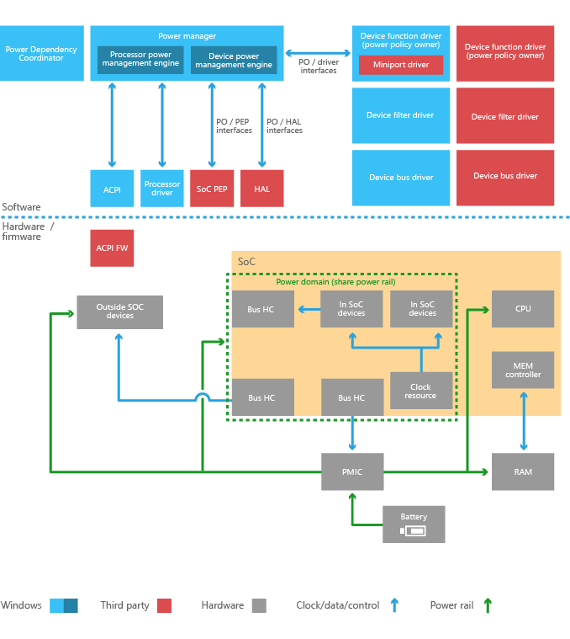

Slide 7
Android Wake lock Mechanism
Android implements an application framework on top of the kernel called Android Power Management Applications Framework
The Android PM Framework is like a driver. It is written in Java which connects to Android power driver through JNI
Currently Android only supports screen, keyboard, buttons backlight, and the brightness of screen
Through the framework, user space applications can use ‘PowerManger’ class to control the power state of the device
ES Seminar
Wakelock

Slide 8
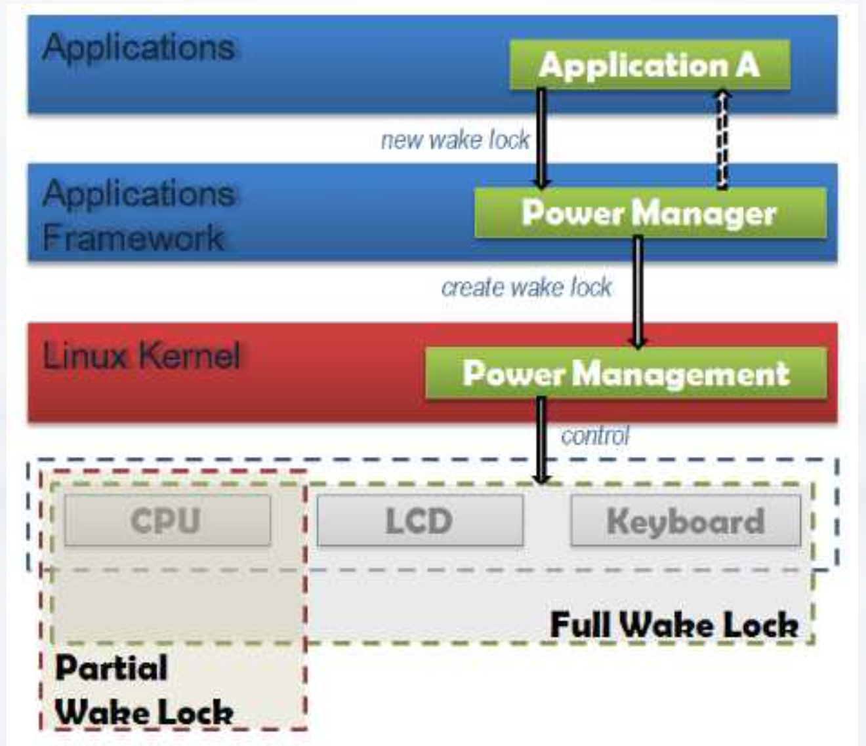
Android Wake lock Mechanism
Notes:
By default, Android tries to put the system into a sleep or better a suspend mode as soon as possible
ApplicationsrunningintheDalvikVMcanpreventthesystemfrom entering a sleep or suspend state, i.e. applications can assure that the screen stays on or the CPU stays awake to react quickly to interrupts
The means Android provides for this task is wake locks
If there are no active wake locks, CPU will be turned off
If there are partial wake locks, screen and keyboard will be turned off

Slide 9
ACPI Specifications
Advanced Configuration and Power Interface (ACPI) specification provides an open standard for device configuration and power management by the operating system.
Power States
Global states
Device states
Processor states
Performance states
ES Seminar
ACPI
Notes:
First released in December 1996, ACPI defines platform-independent interfaces for hardware discovery, configuration, power management and monitoring. With the intention of replacing Advanced Power Management, the MultiProcessor Specification and the Plug and Play BIOS Specification,[1] the standard brings power management under the control of the operating system, as opposed to the previous BIOS-central system which relied on platform-specific firmware to determine power management and configuration policy.[2] The specification is central to Operating System-directed configuration and Power Management (OSPM), a system implementing ACPI which removes device management responsibilities from legacy firmware interfaces.

Slide 10
ACPI Specifications
ACPI specification defines the following four Global ‘Gx’ states and six Sleep ‘Sx’ states for an ACPI-compliant computer-system:
Legacy State : The state on an operating system which does not support ACPI. In this state, the hardware and power are not managed via ACPI, effectively disabling ACPI.
G0 (S0)
Working
‘Awaymode’ is a subset of S0, where monitor is off but background tasks are running
G2 (S5), Soft Off
G3, Mechanical Off
The computer's power has been totally removed via a mechanical switch
ES Seminar
ACPI
Notes:
First released in December 1996, ACPI defines platform-independent interfaces for hardware discovery, configuration, power management and monitoring. With the intention of replacing Advanced Power Management, the MultiProcessor Specification and the Plug and Play BIOS Specification,[1] the standard brings power management under the control of the operating system, as opposed to the previous BIOS-central system which relied on platform-specific firmware to determine power management and configuration policy.[2] The specification is central to Operating System-directed configuration and Power Management (OSPM), a system implementing ACPI which removes device management responsibilities from legacy firmware interfaces.

Slide 11
ACPI Specifications
G1, Sleeping, subdivides into the four states S1 through S4:
S1 : All processor caches are flushed, and the CPU(s) stop executing instructions. Power to the CPU(s) and RAM is maintained; devices that do not indicate they must remain on may be powered down
S2: CPU powered off. Dirty cache is flushed to RAM
S3(mem): Commonly referred to as Standby, Sleep, or Suspend to RAM. RAM remains powered
S4: Hibernation/Suspend-to-Disk - All content of main memory is saved to non-volatile memory such as a hard drive, and is powered down
ES Seminar
ACPI
Notes:
First released in December 1996, ACPI defines platform-independent interfaces for hardware discovery, configuration, power management and monitoring. With the intention of replacing Advanced Power Management, the MultiProcessor Specification and the Plug and Play BIOS Specification,[1] the standard brings power management under the control of the operating system, as opposed to the previous BIOS-central system which relied on platform-specific firmware to determine power management and configuration policy.[2] The specification is central to Operating System-directed configuration and Power Management (OSPM), a system implementing ACPI which removes device management responsibilities from legacy firmware interfaces.

Slide 12
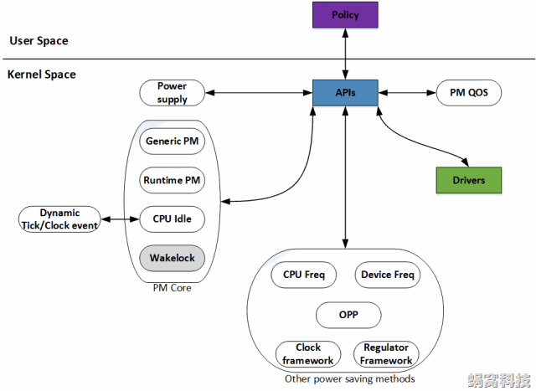
Linux Energy & Power Management
Notes:
System-wide PM
Global energy-saving states
Whole system PM transitions
User space decides which energy-saving state to go to and whenRuntime (working state) PM
User space processes run
Individual CPU or I/O device energy saving utilized

Slide 13
Power management for TinyOS & Contiki
TinyOS
Scheduler responsible for power management
Power management
Radio power management
Managing power of sensor nodes
Power-Save mode
Low-power mode (e.g. TinyOS Timer)
Contiki OS
No standard mechanisms for managing the power state of peripheral devices
Power optimizations
Micro-controller in a sleep mode
Power estimation as additional feature
ES Seminar
EPM for RTOS

Slide 14
Power management integrated circuit
Power management integrated circuits (power management ICs or PMICs) are integrated circuits (or a system block in a system-on-a-chip device) for managing power requirements of the host system.
A PMIC is often included in battery-operated devices such as mobile phones and portable media players.
A PMIC may include the following parts:
Battery management
Voltage regulations
DC to DC conversion (dynamic voltage scaling)
Power sequencing
Miscellaneous functions
ES Seminar
PMIC
Notes:
voltage regulation is a measure of change in the voltage magnitude between the sending and receiving end of a component, such as a transmission or distribution line.

Slide 15
Dynamic frequency scaling
Also known as CPU throttling, whereby the frequency of a microprocessor can be automatically adjusted “on the fly”, either to conserve power or to reduce the amount of heat generated from the chip
Dynamic voltage scaling is another power conservation technique that is often used in conjunction with frequency scaling, as the frequency that a chip may run at is related to the operating voltage.
According to the ACPI Specs, the C0 working state of a modern-day CPU can be divided into the so-called "P"-states (performance states) which allow clock rate reduction and "T"-states (throttling states) which will further throttle down a CPU (but not the actual clock rate) by inserting STPCLK (stop clock) signals and thus omitting duty cycles.

Slide 16
Power management integrated circuit
Some models feature a low-dropout regulator (LDO), and a real-time clock (RTC) co-operating with a backup battery.
A PMIC can use pulse-frequency modulation (PFM) and pulse-width modulation (PWM). It can use switching amplifier (Class-D electronic amplifier).
Most of the PMIC are integrated with the processor design and they are provided by the chip manufacturers
ES Seminar
PMIC
Notes:
voltage regulation is a measure of change in the voltage magnitude between the sending and receiving end of a component, such as a transmission or distribution line.

Slide 17
Further References
Chameleon: Application Level Power Management with Performance Isolation, Xiaotao Liu, Prashant Shenoy, Mark Corner
Ghosts in the Machine: Interfaces for Better Power Management, Manish anand, Edmund B. Nightngale
Embedded Linux Optimizations, Michael Opdenacker, Thomas Petazzoni, Free Electrons
Android Power Management, Jerrin Shaji George
The Case for Higher-Level Power Management, Carla Schlatter Ellis
Hierarchical Power Management with Application to Scheduling, Peng Rong, Massoud Pedram
Power Management in Mobile Devices, Findlay Shearer
Etc..
ES Seminar
References

Slide 18
Thank you!

